Slide 1
April 17, 2015 | Boston, ma
The Future of Solar Energy Resources in New England
New England Electricity Restructuring Roundtable
Jon Black
Lead Engineer, System Planning

Slide 2
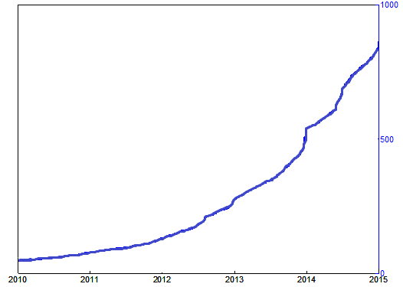
Rapid Growth of Solar PV in New England
Historically, solar photovoltaic (PV) resource deployment was low and had little impact on the grid
Today, state policy goals in all New England states are driving significant growth
Massachusetts is driving this growth with a goal of 1,600 MW installed by 2020
From a handful, to over 900 MW in 5 years
MW
Source: ISO survey of distribution owners

Slide 3
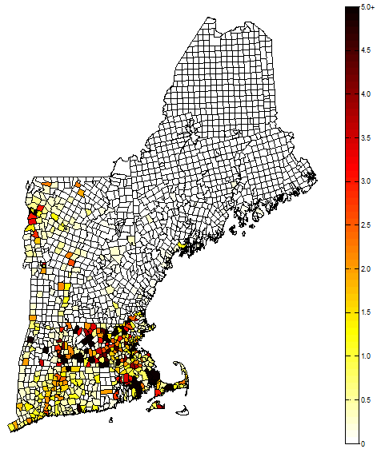
PV Installations Are Located Close to Load
State and Federal Policies Drive Growth
State | Installed Nameplate Capacity (MW_{AC})
Massachusetts | 666.83
Connecticut | 118.80
Vermont | 81.85
Rhode Island | 18.21
New Hampshire | 12.71
Maine | 10.38
New England Total | 908.78
Note: total installed PV by municipality (MW)
Source: ISO survey of distribution owners, as of
12/31/14

Slide 4
ISO New England Takes Action to Plan for Growth of PV
Forecasting for Planning
Forecasting for Operations
Established the Distributed Generation Forecast Working Group (DGFWG) in 2013 to provide advice on PV issues
Working with the DGFWG, in 2014, the ISO developed the nation’s first regionally-focused forecast of future growth of PV resources
We just released the second solar PV forecast
Collaborating with industry leaders to develop tools to account for PV within operational load forecasts
This public-private partnership is using advanced computing technology to provide grid operators with forecasts of PV performance
Funded by the US Department of Energy and led by IBM
Notes:
See slide 23: http://www.iso-ne.com/static-assets/documents/committees/comm_wkgrps/prtcpnts_comm/pac/mtrls/2014/feb192014/a3_pv_forecast_dg_integration_update.pdf

Slide 5
Here Comes the Sun Strong Growth in Solar PV Forecasted
Source: Final PV Forecast (April 2015); Note: MW values are AC nameplate

Slide 6
The PV Forecast Will Help Shape ISO Activities
PV forecast is used in transmission planning studies
Needs Assessments and Solutions Studies
Generator System Impact Studies
Transmission Proposed Plan Application Supporting Studies
The ISO is currently exploring how to reflect forecasted PV that will not participate in ISO markets in the long-term load forecast that will be used to calculate the quantity of the installed capacity requirement for the tenth Forward Capacity Auction to be held next year.

Slide 7
From the Grid Management Perspective, Challenges Remain for PV Integration
Current state-jurisdictional interconnection standards
Are not intended for significant PV penetrations
Do not provide adequate grid support
Raise potential long-term reliability concerns
Data Acquisition
The ISO needs data from distributed resources to create an accurate forecast, but we don’t have direct access to this information
Data needs include PV capacity and energy production
Currently, the ISO relies on the states and utilities in an ad hoc basis for data collection
The ISO is addressing PV integration challenges in a way that we believe will facilitate the achievement of public policy goals

